Slide 1

Capstone Project – I: Review – 2 on In-Cabin Health Monitoring System for Passengers Safety in Semi-Autonomous Vehicles
Presented by the Batch No. : IOT-15
GALI ROHITH BU22CSEN0600072(TL)
P SURENDRA BU22CSEN0600049
G S VIKRAM BU22CSEN0600040
K RAM PRASAD BU22CSEN0600140
S B JEEVAN BU22CSEN0600194
Under the Guidance of
Dr. ANANDHAN K
Assistant Professor
Department of Artificial Intelligence & Data Science
GITAM School of CSE, GITAM (Deemed to be University),
Bengaluru, Karnataka, INDIA.

Slide 2
CONTENTS
Abstract
Problem Statement
Objectives
Feedback from Guide/Reviewers and actions taken after Review-1
Requirement Analysis
Identification of tools/technology/algorithms
Design Strategy (project workflow/ system design/ DFD/UML design)
Conclusion
References

Slide 3
Problem Statement
In autonomous vehicles, if a passenger experiences a sudden medical emergency while traveling, the autonomous system is currently unable to recognize the situation or provide an appropriate response. Autonomous systems lack the capability to monitor passenger health, detect emergencies, and deliver necessary support. This limitation poses a significant risk to passenger safety in autonomous vehicle systems.

Slide 4
Objective
The project aims to track passenger health using an ECG sensor and a live camera for continuous monitoring. Camera data will be processed using deep learning models such as YOLOv8, ResNet, PoseNet, and GazeNet to detect and analyze passenger behaviour. The fusion of camera and sensor data will be implemented using the Jetson AGX SDK (HPC) to enable efficient real-time processing. Finally, the developed system model will be validated by integrating it into a real buggy for performance evaluation and testing under real-world conditions.

Slide 5
Feedback from Guide/Reviewers and actions taken after Review-1
Feedback from Reviewers
Write the objective in a single paragraph.
Feedback from Guide
Ensure the proper analysis for the research gap.
Identify the ECG sensor working principle and find the integration into the Jetson board.
Actions Taken:
We have changed the objective as per the guidance.
We have also gone through the research papers.
We have worked on detecting heart electrical signals, and our next step is to integrate it with the Jetson board.

Slide 6
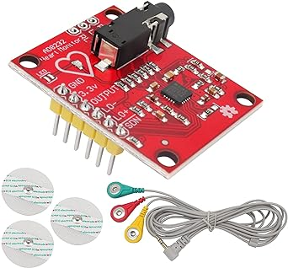
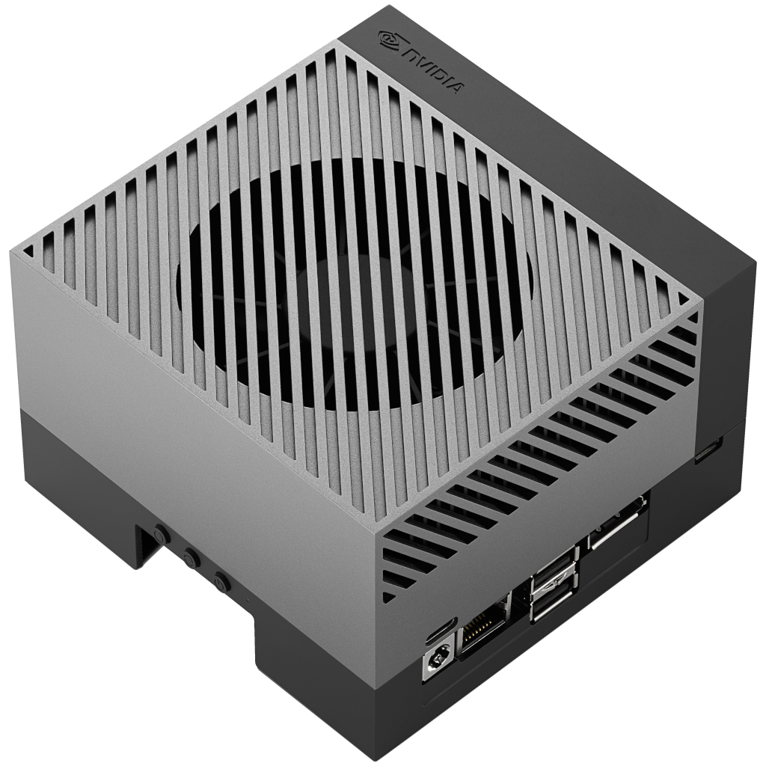
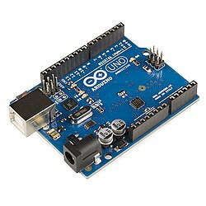
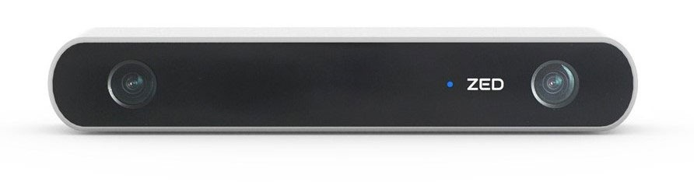
Requirement Analysis
Hardware Requirements
ECG Sensor
Arduino UNO R3
NVIDIA AGX Orin Jeston SDK
ZED 2 Camera

Slide 7





Requirement Analysis
Software Requirements
Python
Arduino IDE
PyTorch
Ubuntu 20.04 LTS
Deep Learning Models

Slide 8
Identification of tools/technology/algorithms
Technologies
Deep Learning
Edge Computing (Nvidia Jeston AGX Orin)
PyTorch
IoT
Linux (Ubuntu 20.04)

Slide 9
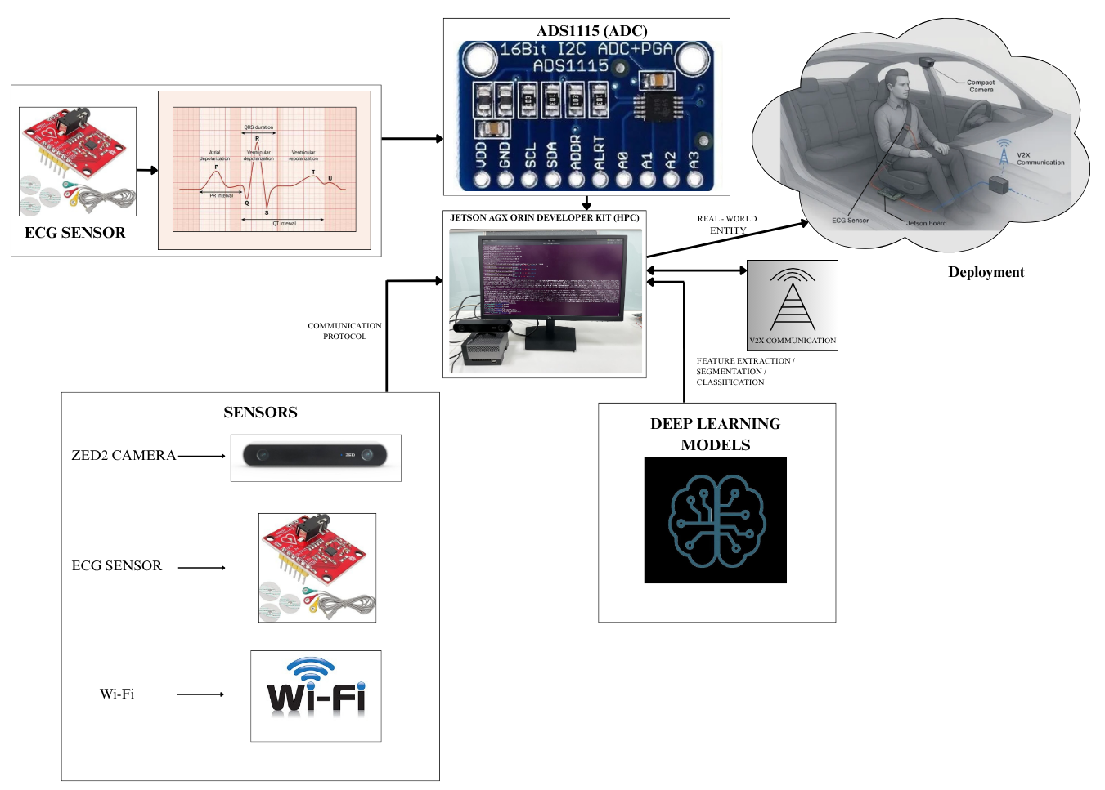
Design Strategy
Overall Architecture Diagram

Slide 10
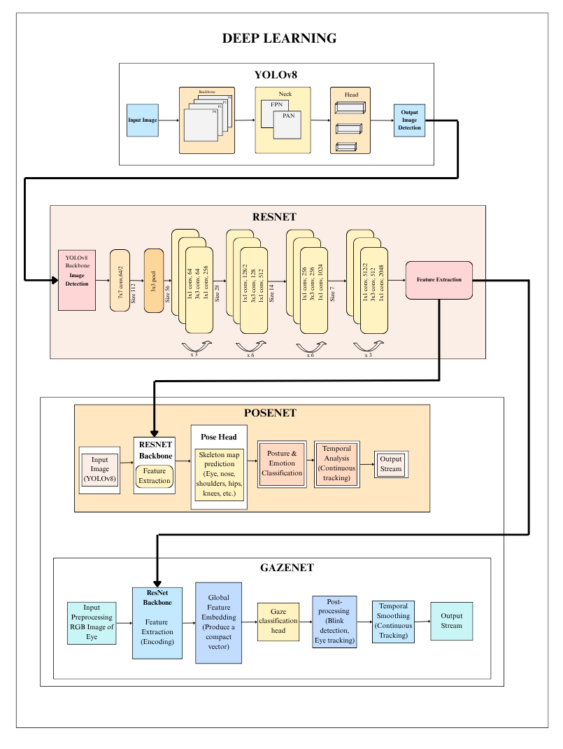
Design Strategy

Slide 11
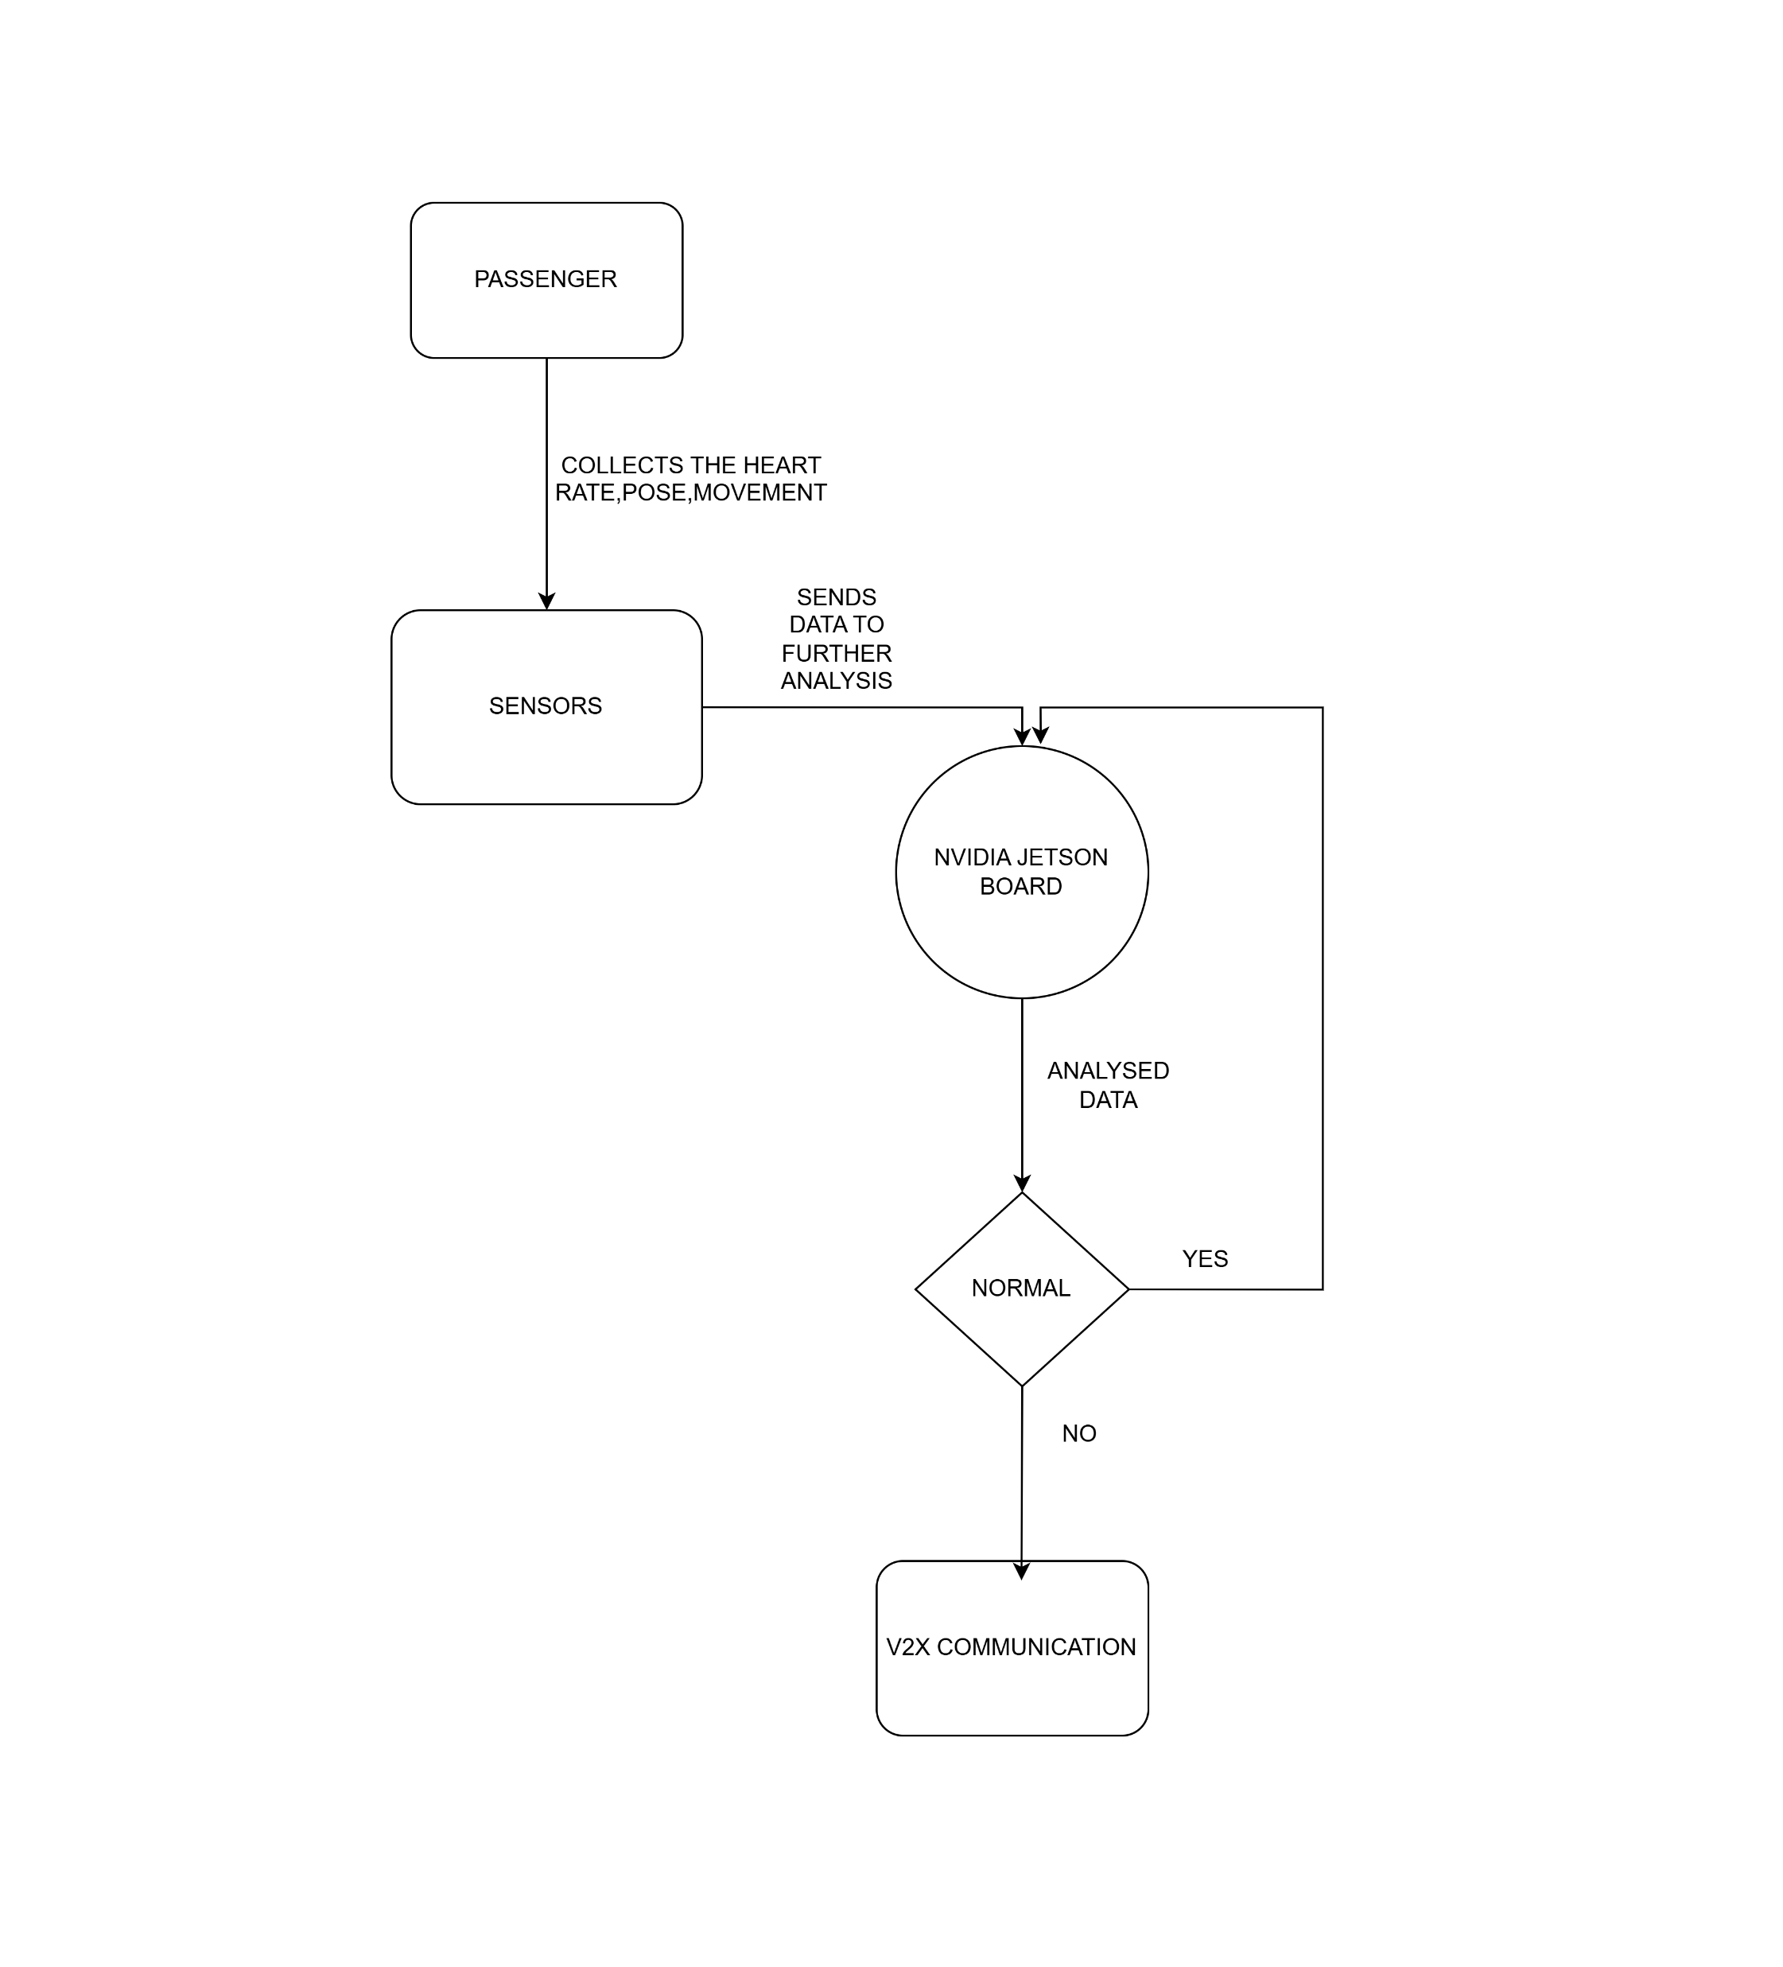
Design Strategy
DFD Diagrams
Fig: Level-0 Diagram

Slide 12
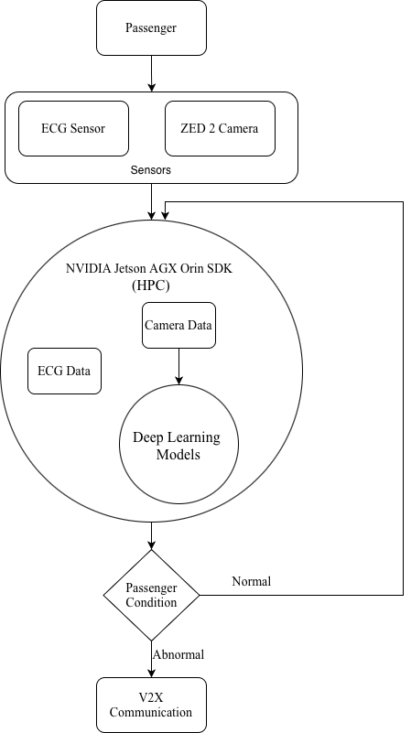
Design Strategy
DFD Diagrams
Fig: Level-1 Diagram

Slide 13
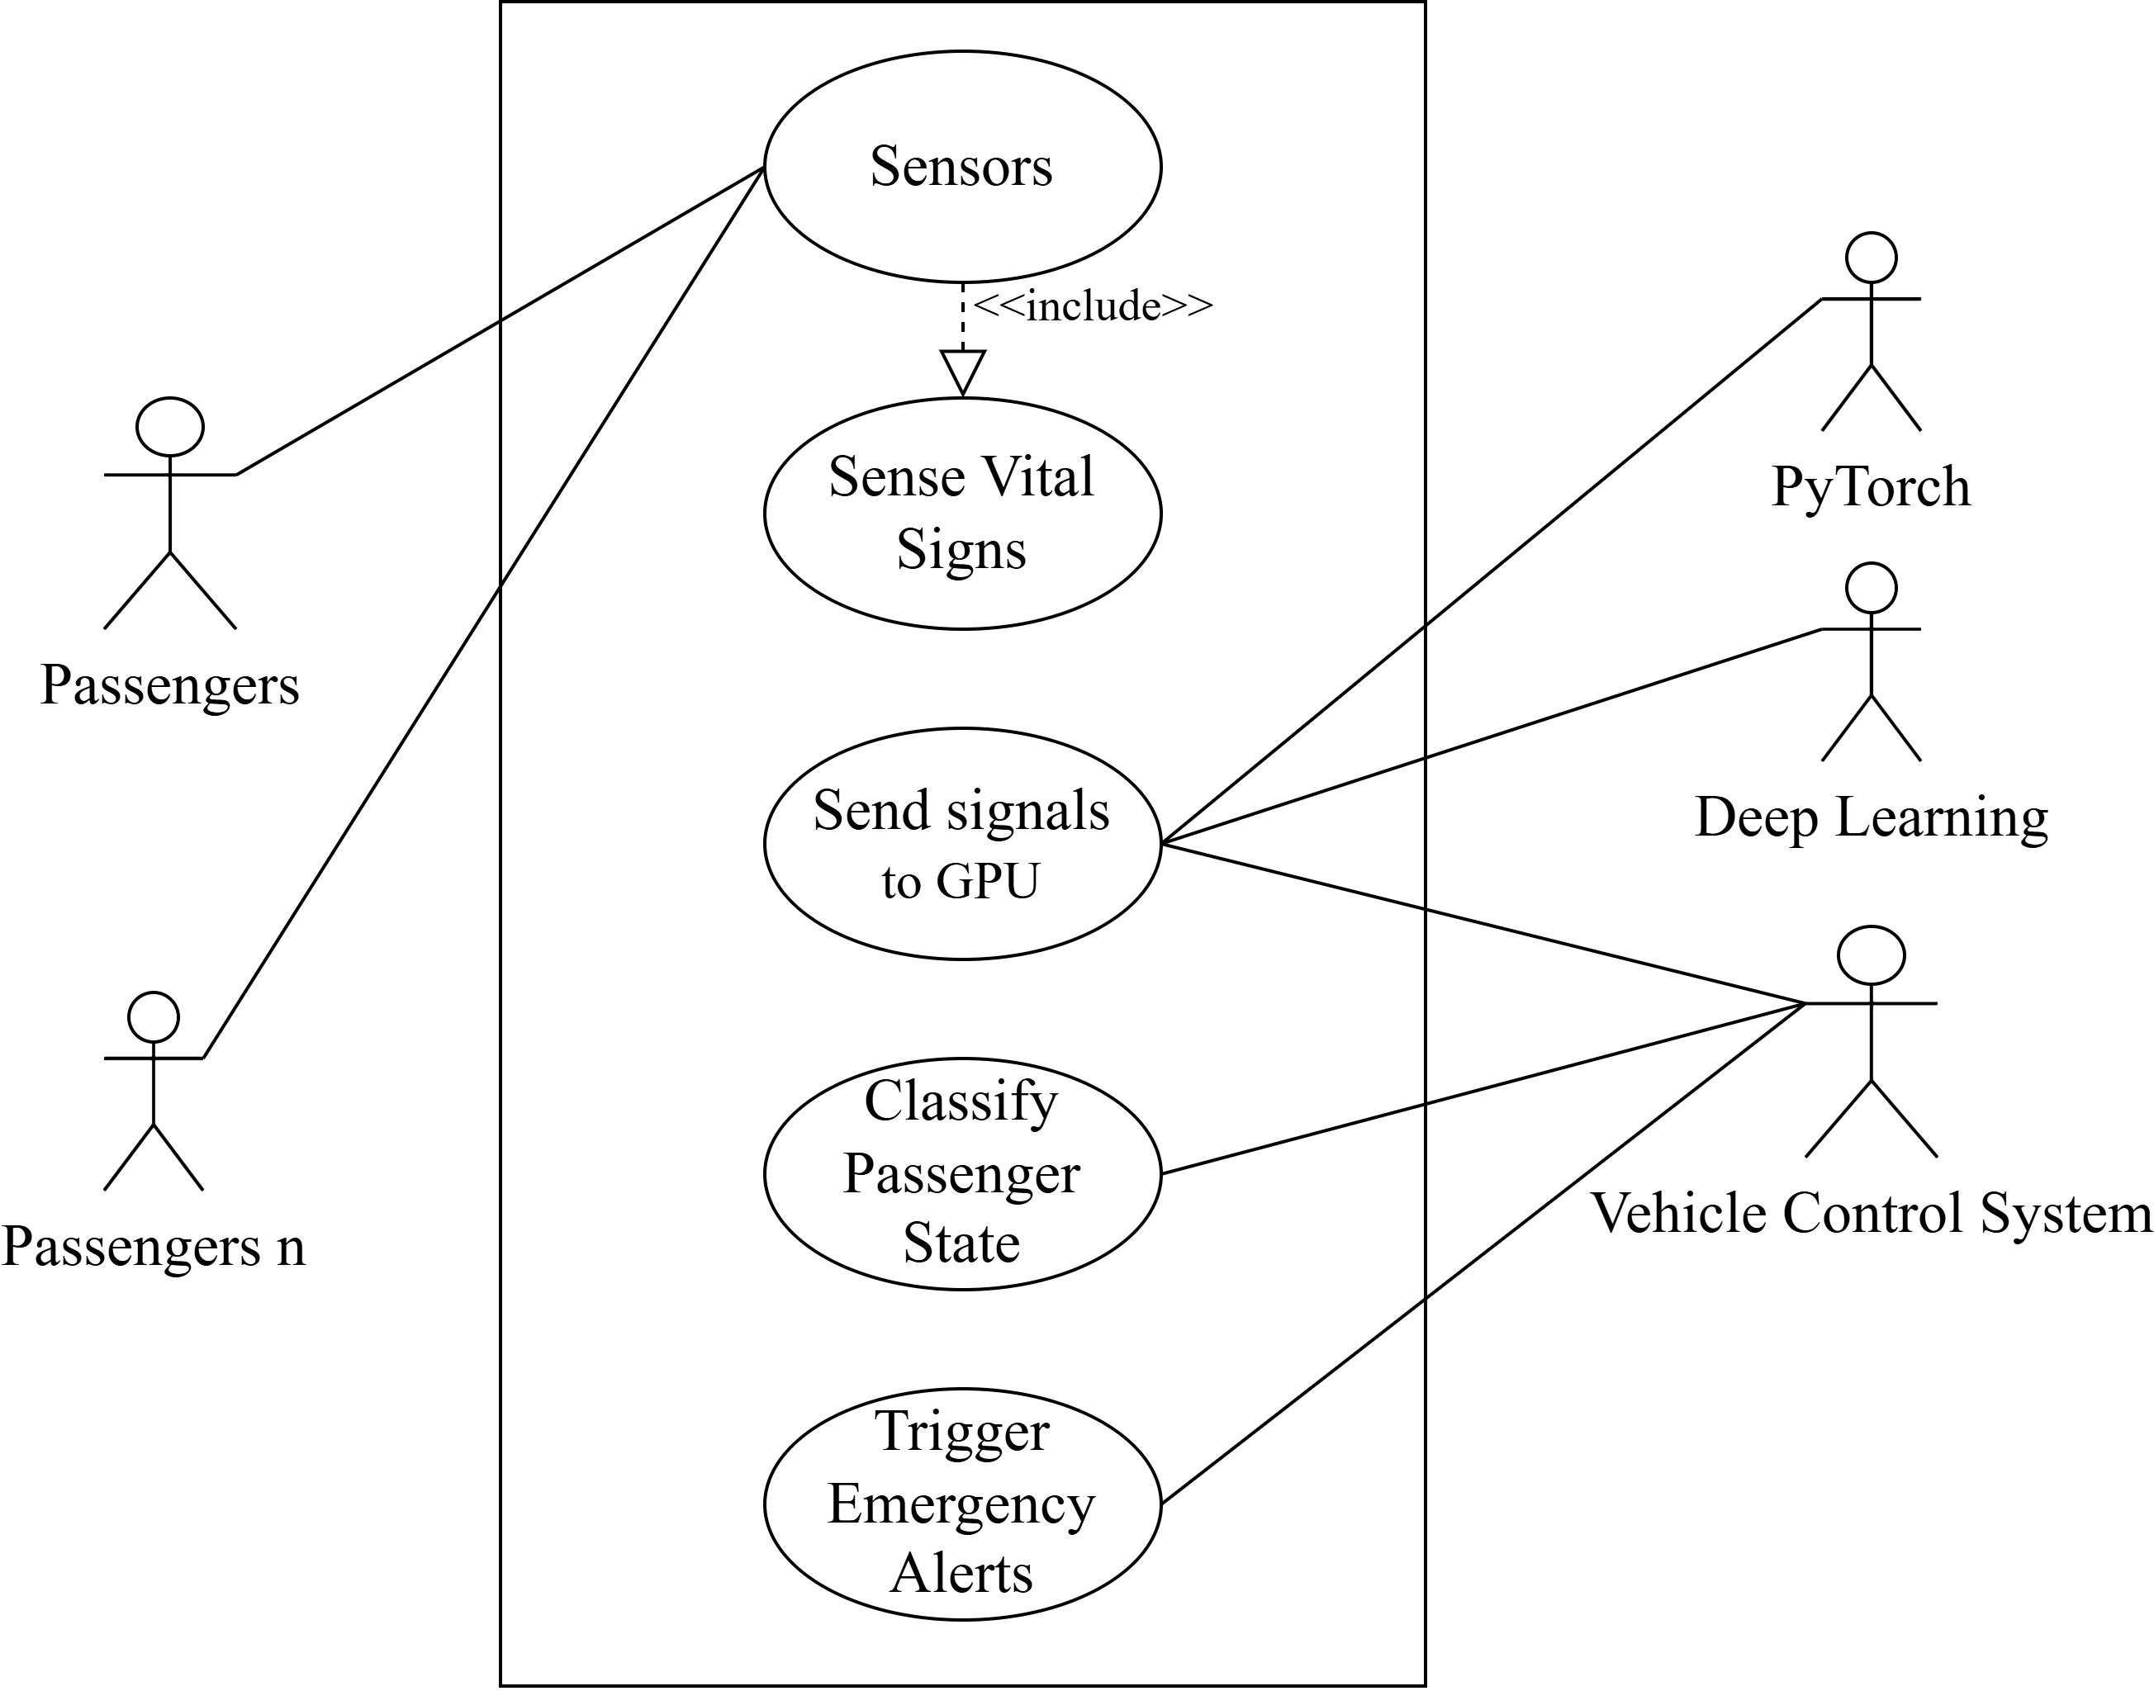
Design Strategy
UML Diagrams
Fig: Use Case Diagram

Slide 14
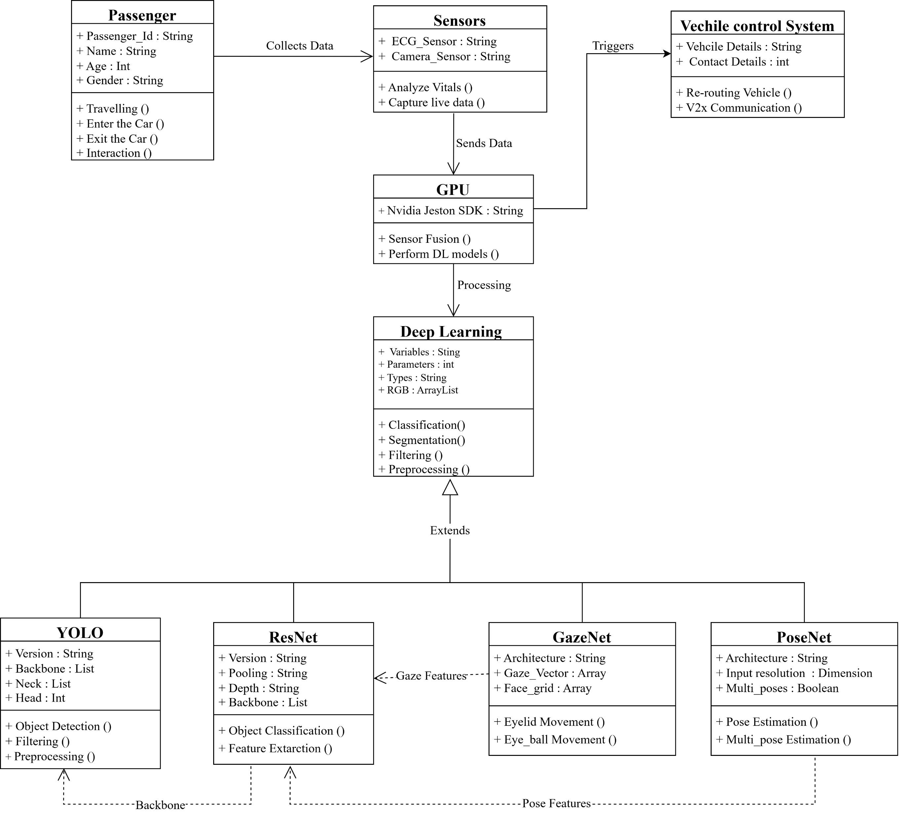
Design Strategy
UML Diagrams
Fig: Class Diagram

Slide 15
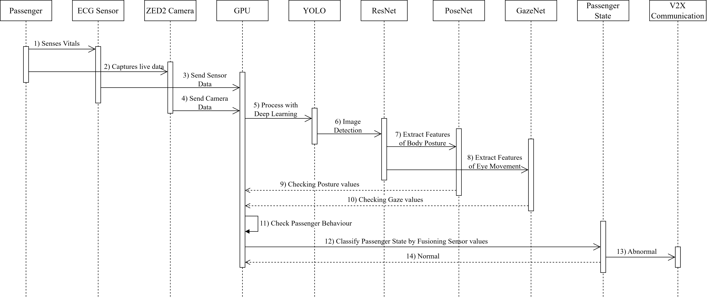
Design Strategy
UML Diagrams
Fig: Sequence Diagram

Slide 16
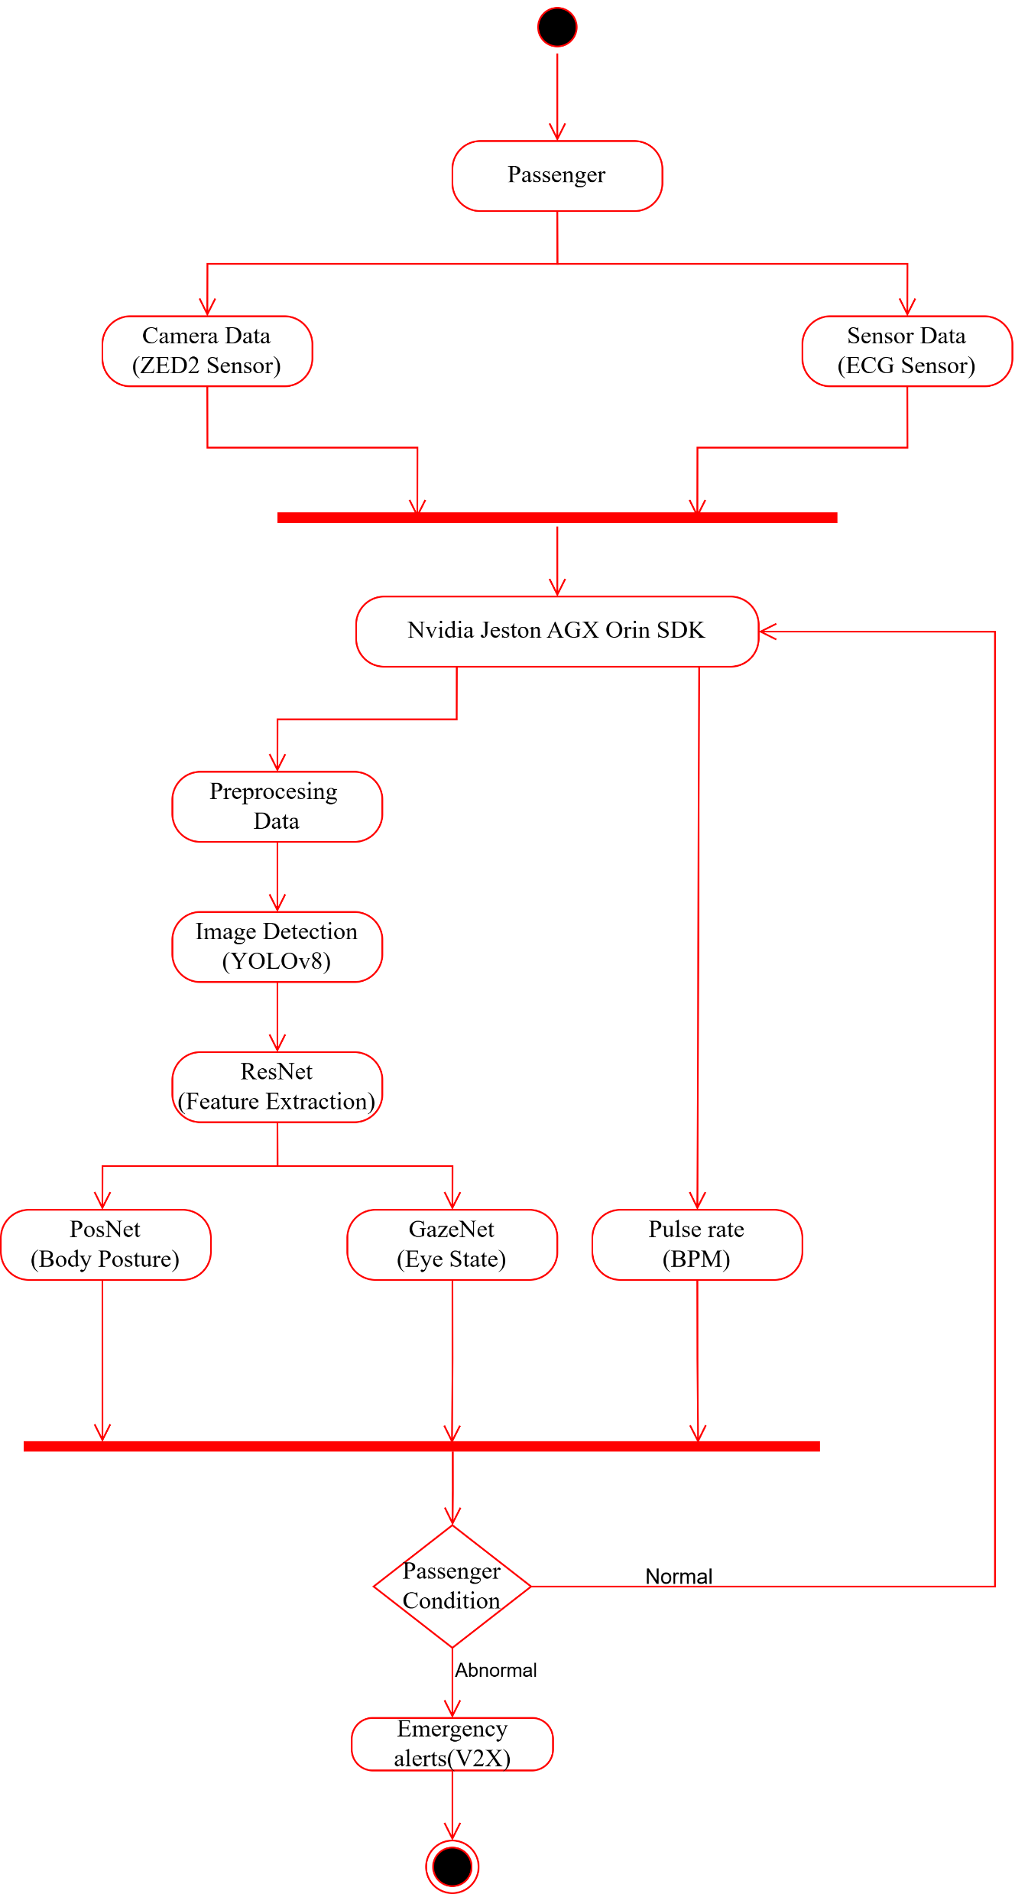
Design Strategy
UML Diagrams
Fig: Activity Diagram

Slide 17
Conclusion
We have completed the literature survey and implemented the ECG acquisition module to collect data. In addition, a dataset has been collected using a ZED 2 camera for visual monitoring and analysis. In the future, we plan to implement a deep learning model to process and analyze both the ECG and camera-based datasets. By integrating these two modules, more accurate and reliable results can be achieved for health monitoring and analysis.

Slide 18
References
[1]Tsiktsiris, Dimitris; Lalas, Antonios; Dasygenis, Minas; Votis, Konstantinos. A complete in‐cabin monitoring framework for autonomous vehicles in public transportation, IET Intelligent Transport Systems, Vol. 19, Issue 1, 2025.
[2]Othman, Walaa; Kashevnik, Alexey; Ali, Ammar; Shilov, Nikolay. DriverMVT: In-Cabin Dataset for Driver Monitoring Including Video and Vehicle Telemetry Information, Data, Vol. 7, No. 5, 2022.
[3]Abedi, H.; Ma, M.; He, J.; Yu, J.; Ansariyan, A.; Shaker, G. Deep Learning-Based In-Cabin Monitoring and Vehicle Safety System Using a 4-D Imaging Radar Sensor. IEEE Sensors Journal, Vol. 23, No. 11, pp. 11296–11309, June 2023.
[4]Global Market Insights. Passenger Vehicle Cabin Monitoring System Market Report, 2025–2034. GMI14285, Automotive Technology – ADAS. June 2025.

Slide 19
References
[5]Mishra, A.; Lee, S.; Kim, D.; Kim, S. In-Cabin Monitoring System for Autonomous Vehicles. Sensors, Vol. 22, No. 12, Article 4360, 2022.
[6]Jacopo Sini, Luigi Pugliese, Sara Groppo, Michele Guagnano, Massimo Violante, Towards In-Cabin Monitoring: A Preliminary Study on Sensors Data Collection and Analysis, arXiv preprint arXiv:2309.11890v1, 2023.
[7]Eva Sharma, CES 2025 stories: In-cabin monitoring technology innovations, M14 Intelligence, Autonomous Mobility section, Jan 16, 2025.

